Slide 1
Success Metrics Workshop
Thursday, October 6th 2023
Notes:
Anna

Slide 2
Agenda
Implementation
Financials
Key Performance Indicators
Risks and Mitigations
Notes:
Anna

Slide 3
Research for Implementation and Risks
Research for Implementation and Risks
Gather
Research
Analyze
Case Prompt
Client documents (website, online articles & reports)
Statistics
Client industry
Breakdown of your recommendations implementation wise
Obstacles companies face or may face when implementing similar ideas
Feasibility of implementation
Evidence of support for best plan
Show how you considered any hole of your recommendations
Implementation | Financials | KPI | Risks and Mitigations

Slide 4
Implementation Plans
Implementation Plans
Your implementation plan should be the “roadmap” of your recommendations
What your plan should include:
Having a client-centered implementation
Detailed breakdown of activities
[short term, long term]
Costs/projected revenues
Consistent time breakdown
[quarters, months, years. etc]
Impactful
Relevant
Feasible
Incorporating Research
Expected difficulties
Use ideologies such as Porter’s 5 forces to get a sense of integration time, feasibility, etc.
Check ins/maintenance of recommendations
[how do we/how often do we check to make
sure the recommendation is being effective?]
Look at comparable companies and how long it took to implement similar recommendations
[Keep company size and scale in mind with this: ex. Burger
King and McDonalds]
Dissect each recommendation into milestones
Implementation | Financials | KPI | Risks and Mitigations

Slide 5
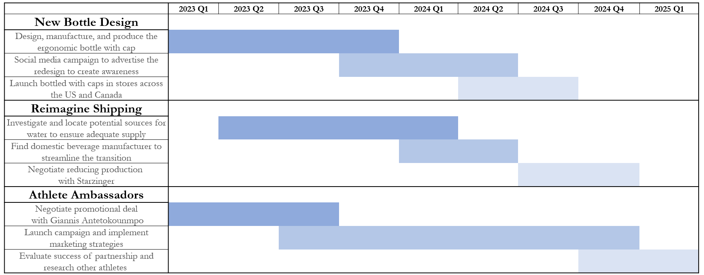
Creating a Timeline - Gantt Chart
Creating a Timeline - Gantt Chart
Gantt Chart
Pros
Ability to clearly show duration of each task
Aesthetically pleasing
Cons
Can be time-consuming to create if the timeline is detailed
(Often times can be a nice appendix slide)
Implementation | Financials | KPI | Risks and Mitigations

Slide 6
Creating a Timeline - Arrow
Creating a Timeline - Arrow
Arrow or Classic Timeline
Pros
Visuals clearly go from present to future
Aesthetically pleasing
Q1 2019
Task #1
Q2 2019
Task #2
Q4 2019
Task #3
Q1 2020
Task #4
Q2 2020
Task #5
Cons
Cannot visually show task duration
Details
Details
Details
Details
Details
May run out of space on slide depending on detail
Implementation | Financials | KPI | Risks and Mitigations

Slide 7
Creating a Timeline - Table
Table
Pros
Ability to include a fairly detailed timeline
Task | Start | End | Duration
Task #1 | Nov-19 | Nov-20 | 1 year
Task #2 | Jan-20 | June-20 | 6 months
Task #3 | Jan-20 | Jan-22 | 2 years
Task #4 | Sep-20 | Mar-21 | 6 months
Task #5 | Jan-21 | Jan-22 | 1 year
Concise, minimalistic layout
Cons
Can’t show single time events
(e.g. launches)
No clear visual representation of task duration
Implementation | Financials | KPI | Risks and Mitigations

Slide 8
Example Problem
Create an implementation plan for this recommendation:
A popular deli in a small town is looking to expand to capture growing demand. Since their deli has developed a strong brand, they are thinking of opening a pizza place sister location to diversify their offerings. Your team assessed the idea, and are recommending the expansion. How would you implement this expansion while considering the risks and goals of the client?
We recommend following this process:
1.) Be sure to consider the specific steps necessary to make this happen
2.) Research how long each step in the implementation would take
3.) Order the steps and create a visual representing your implementation
Implementation | Financials | KPI | Risks and Mitigations

Slide 9
Example Problem (cont.)
Example Problem (cont.)
Create an implementation plan for this recommendation:
A popular deli in a small town is looking to expand to capture growing demand. Since their deli has developed a strong brand, they are thinking of opening a pizza place sister location to diversify their offerings. Your team assessed the idea, and are recommending the expansion. How would you implement this expansion while considering the risks and goals of the client?
1.) Consider the specific steps necessary to make this happen
Securing funds (How will we raise money? That has its own implementation)
Researching and choosing the property location (Thinking of demographics)
Purchasing the property
Marketing (How will you market this new location and for how long?)
Property renovations (Depending on what you bought, how much needs to be changed?)
Hiring and training new workers (How long is the training process?)
Store opening
Implementation | Financials | KPI | Risks and Mitigations

Slide 10
Example Problem (cont.)
Create an implementation plan for this recommendation:
A popular deli in a small town is looking to expand to capture growing demand. Since their deli has developed a strong brand, they are thinking of opening a pizza place sister location to diversify their offerings. Your team assessed the idea, and are recommending the expansion. How would you implement this expansion while considering the risks and goals of the client?
2.) Research how long each step in the implementation would take
3.) Order the steps and create a visual representing your implementation plan
Task | Start | End | Duration
Choose ideal location | May 15, 2019 | August 15, 2019 | 3 months
Purchase property | Aug. 15, 2019 | Sept. 15, 2019 | 1 month
Marketing | Sept. 15, 2019 | Mar. 15, 2019 | 6 months
Renovate property | Oct. 1, 2019 | Mar. 1, 2019 | 5 months
Hire and train new workers | Jan. 1, 2019 | Mar. 1, 2019 | 2 months
Implementation | Financials | KPI | Risks and Mitigations

Slide 11
Financial Modeling Key Ideas
Financial Modeling Key Ideas
What is a Financial Model?
Provides quantitative expectations for qualitative ideas Shows future financial viability of an idea, program, company, etc.
How are Financial Models Made?
All financial models are grounded in logic Use data gathered from SEC filings (public companies), competitors, or industry news
Implementation | Financials | KPI | Risks and Mitigations

Slide 12
Detail vs. Accuracy
Detail vs. Accuracy
Forecasts of great of detail are often less accurate
But…
The most accurate projections often lack detail
How do we strike a balance?
Implementation | Financials | KPI | Risks and Mitigations

Slide 13
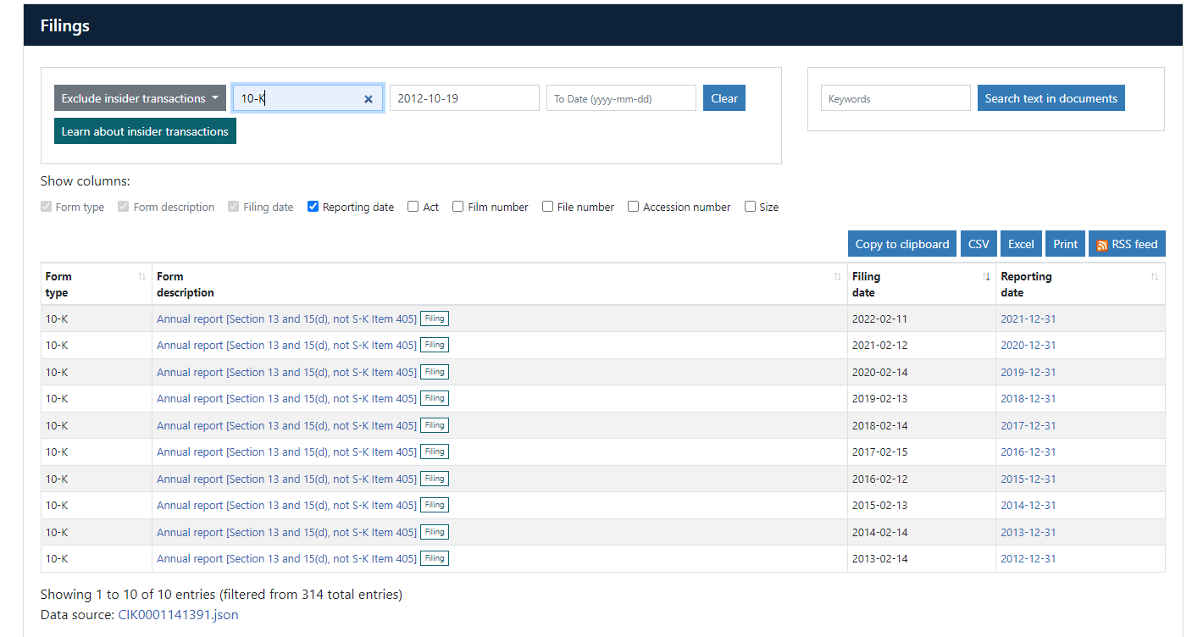
How to Find Financial Statements
SEC Edgar
All publicly traded companies must report their financial statements to the SEC Use the SEC website to find filing and export them to excel 10-k filings may be the most useful as they compile statements at the year’s end Income Statement, Balance Sheet, Statement of Cash Flows
Implementation | Financials | KPI | Risks and Mitigations

Slide 14
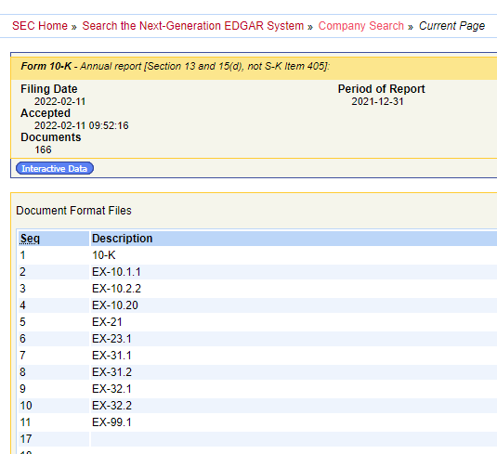
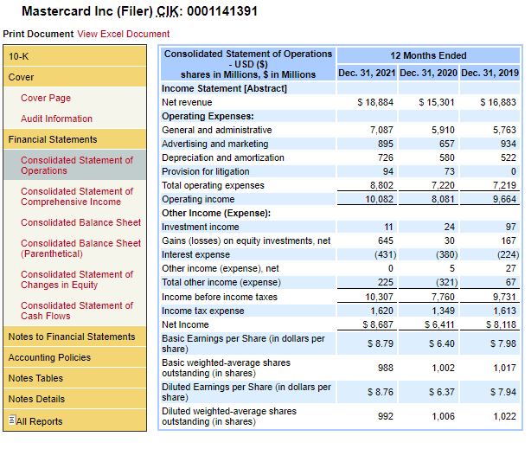
How to Find Financial Statements
Implementation | Financials | KPI | Risks and Mitigations

Slide 15
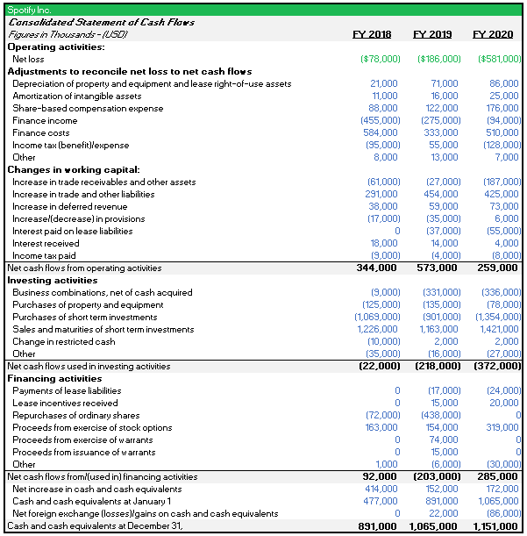
Formatting in Excel
Basic Tips For Formatting
Make all hard coded cells blue font, formula cells black, and linked cells green Years should be ascending from left to right Utilize the indent function to make line items easier to read Finalized statements should have no gridlines, only borders Negative numbers should be in parenthesis
Implementation | Financials | KPI | Risks and Mitigations

Slide 16
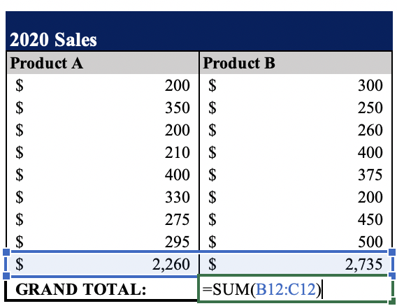
Excel Concepts to Keep in Mind
Cell referencing is usually better than hard coding.
Organizing and labeling your work is crucial.
Detail and accuracy is an important relationship.
An example of cell reference.
Implementation | Financials | KPI | Risks and Mitigations
Notes:
Anna

Slide 17
Projecting Financial Statements
Revenue Build
Projected Income Statement
Revenue is NOT profit
Projecting revenue is one way of showing how much of the market share a company is gaining
Two main approaches are Top Down and Bottom Up
Shows your recommendations effect on company expenses
Directly linked to your revenue build
Expenses are projected as a percent of revenue
Implementation | Financials | KPI | Risks and Mitigations

Slide 18
Projecting Revenue
Top Down
Looks at industry growth and market share as a whole Bases revenue assumptions on mainly macroeconomic changes in the industry as a whole Recommendations can be incorporated as a calculation of how much the companies market share will grow as a result of the recommendation
Bottom Up
This looks at certain sectors of the company and labels them with individual growth Segment revenue is added to find the total projected revenue for each year Recommendations can be incorporated as a calculation of how each sector of the company’s revenue will be positively or negatively effected
Or
Implementation | Financials | KPI | Risks and Mitigations

Slide 19
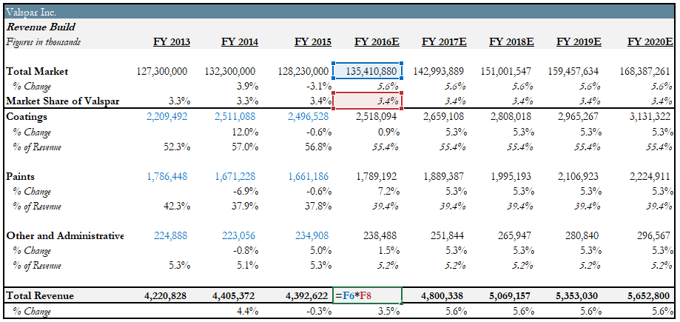
Top Down Example
Top Down Example
Implementation | Financials | KPI | Risks and Mitigations

Slide 20
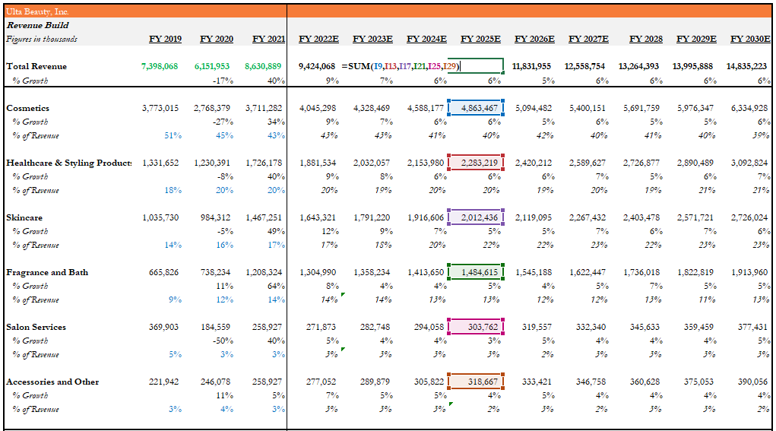
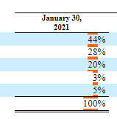
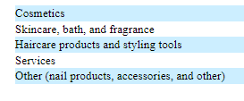
Bottom Up Example
Implementation | Financials | KPI | Risks and Mitigations

Slide 21
Introductory Methods of Modeling
Introductory Methods of Modeling
Comprehensive financial models will show a link between individual recommendations and the whole company using a combination of these two methods.
Recommendation Approach
Income Statement Approach
Financial viability of one idea
Includes thoughtful detail and critical thinking
“Big picture” of future financial position
Involves projecting revenue and expenses
Implementation | Financials | KPI | Risks and Mitigations
Notes:
Josh

Slide 22
Key Steps for Recommendation Approach
Key Steps for Recommendation Approach
Understanding an Idea
Do you fully comprehend this idea before making projections?
Classify the Attributes
Will this idea increase revenue, decrease expenses, both?
Find Quantitative Estimates for Each Part
Begin to determine how much ideas will cost or gain in revenue?
Summarize, Analyze and Check for Logic
Is this model positive for the firm? Does it make sense, is it realistic and attainable?
Implementation | Financials | KPI | Risks and Mitigations
Notes:
Josh

Slide 23
Key Steps for Income Statement Approach
Key Steps for Income Statement Approach
Gather Industry Knowledge
Research Company Goals and History
Use Percentages to Understand Financials
Add Implications of Recommendations
Understand the current state of the industry and the direction it is moving
Make sure projections make sense with the economy and key competitors
Understand how the company has recently performed and why it has performed that way
Understand its goals moving forward and possible barriers
Financial documents are often cluttered with seemingly insignificant figures
Growth rates (as percent's) are easy ways to identify trends
Recommendation affects expenses and/or revenues for a business
Add these as separate line items to easily quantify the impact of an idea
Implementation | Financials | KPI | Risks and Mitigations
Notes:
Josh

Slide 24
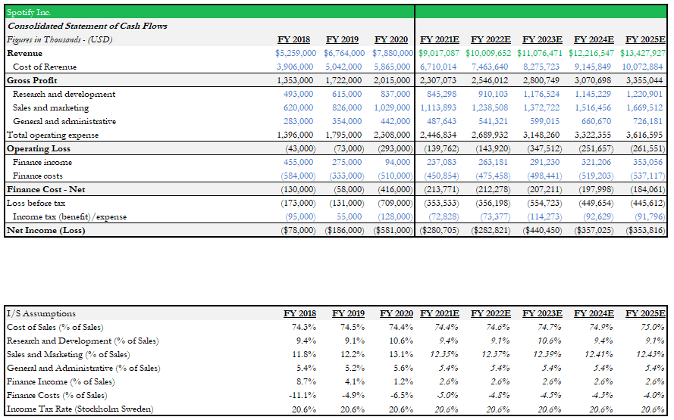
Projected Income Statement Example
Implementation | Financials | KPI | Risks and Mitigations

Slide 25
Presenting Financials
Slides to Present
Slides to Reference
Presentation Slides
Appendix Slides
Graphs and Charts
Summary Figures
Excel Worksheets
Detailed Analysis
Implementation | Financials | KPI | Risks and Mitigations
Notes:
Anna

Slide 26
Financial Presentations Do’s and Don’ts
Financial Presentations Do’s and Don’ts
Do
Don’t
Memorize a few key financial data points to use during presentations
Rely on one team member to answer all questions or have more than two people answer a question
Be comfortable speaking on qualitative and quantitative aspects
Overload a slide with too many numbers and computations
Implementation | Financials | KPI | Risks and Mitigations
Notes:
Anna

Slide 27
Creating Professional Graphs
Creating Professional Graphs
Remain within Theme
Needs Improvement
Indicate Important Dates
Use Labels
Remove Stock Formatting
Better
Remember Perspective
Implementation | Financials | KPI | Risks and Mitigations
Notes:
Anna

Slide 28
A Guided Example
In a recent case study involving Walmart, MCG Consulting recommends that Walmart implements one day shipping through a subscription service similar to Amazon Prime.
Key Questions to Be Answered:
How do we project how much money it will cost to implement one day shipping and how much money will the company make from it?
How well does this fit into the financial projection of the whole company?
Is our recommendation logical and sustainable?
Implementation | Financials | KPI | Risks and Mitigations
Notes:
Josh

Slide 29
Breaking Down an Idea
Walmart One Day Shipping Initiative
Would Walmart customers value one day shipping?
How can we keep the subscription at a low price?
Who can Walmart partner with to implement one day shipping?
How can we ensure the products are delivered on time?
What are the costs associated with one day shipping?
How will expenses differ between one day shipping and normal shipping?
How many customers will be retained as a result?
What is the revenue gained from our loyal customers?
Implementation | Financials | KPI | Risks and Mitigations
Notes:
Josh

Slide 30
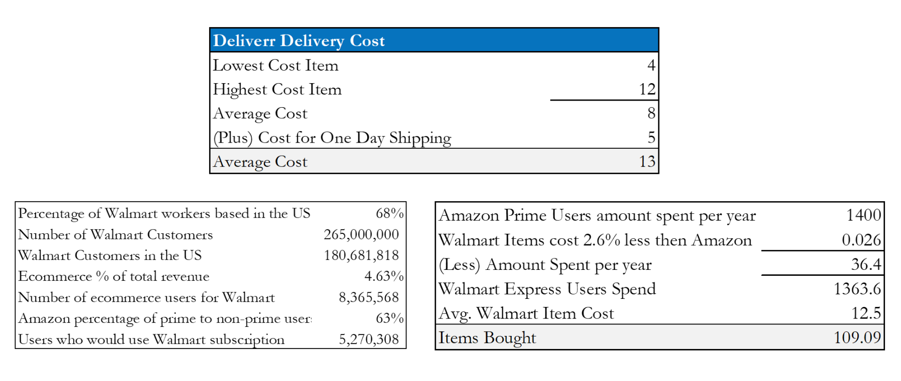
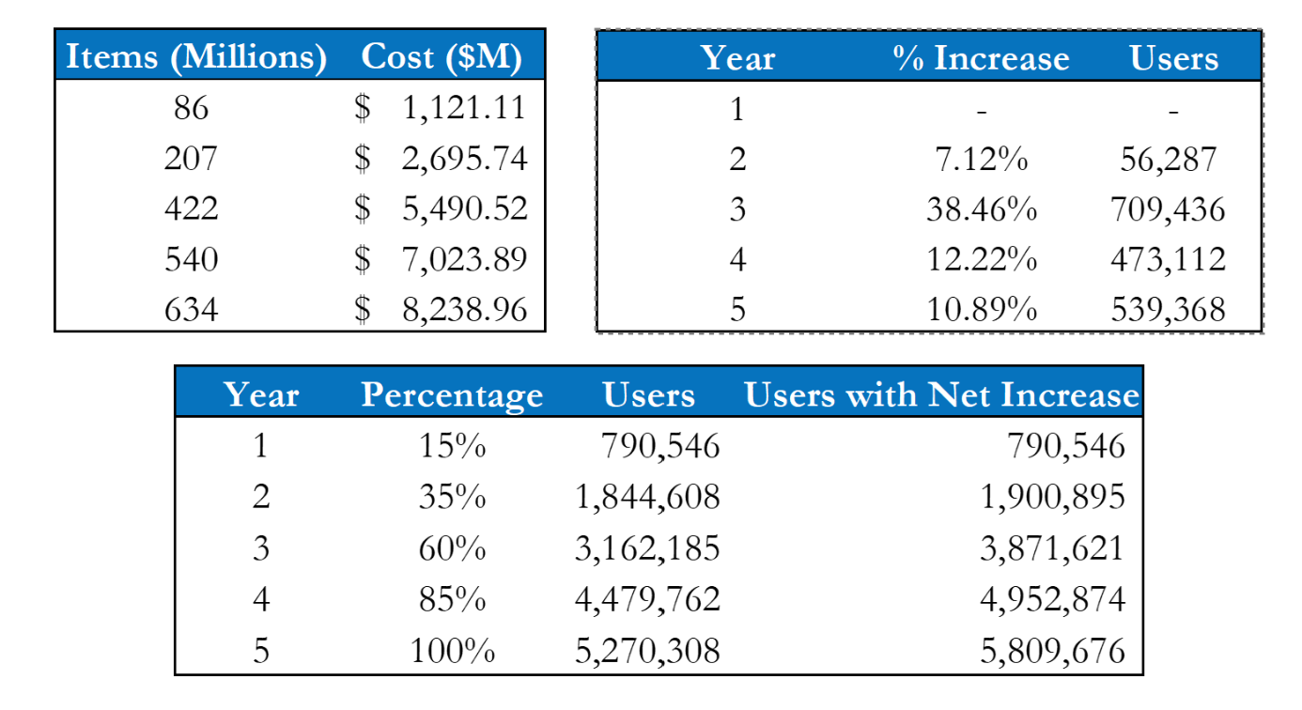
Providing Quantitative Justification - Expenses
Providing Quantitative Justification - Expenses
Slide Takeaways
Appendix worksheet (not presented) This worksheet tracked the increase in users while also finding the average online order cost Estimates were pulled both from Deliverr, who would be performing the deliveries, and from Amazon in order to arrive at final results Citing the sources adds a dimension of reliability to the forecasts
Implementation | Financials | KPI | Risks and Mitigations
Notes:
Josh

Slide 31
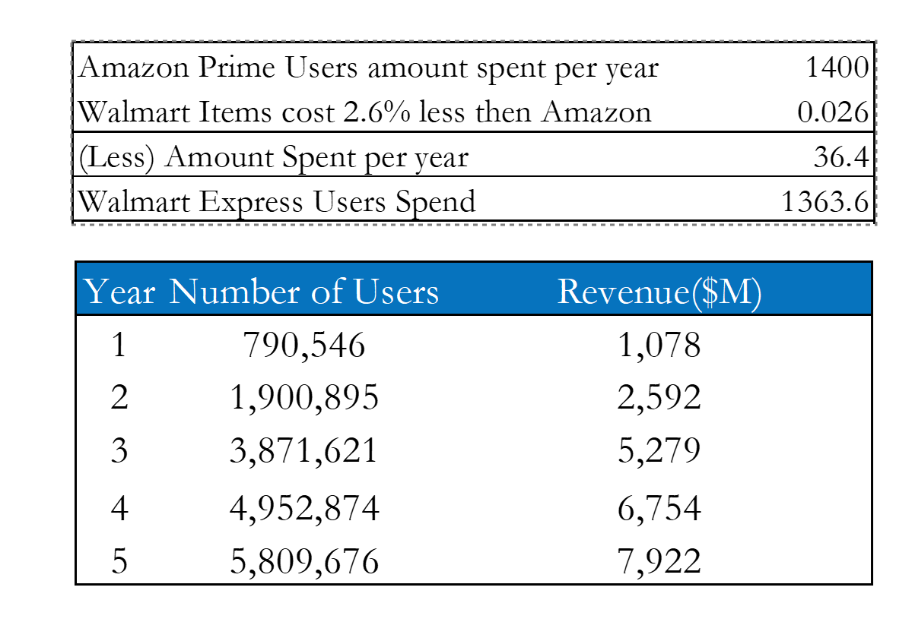
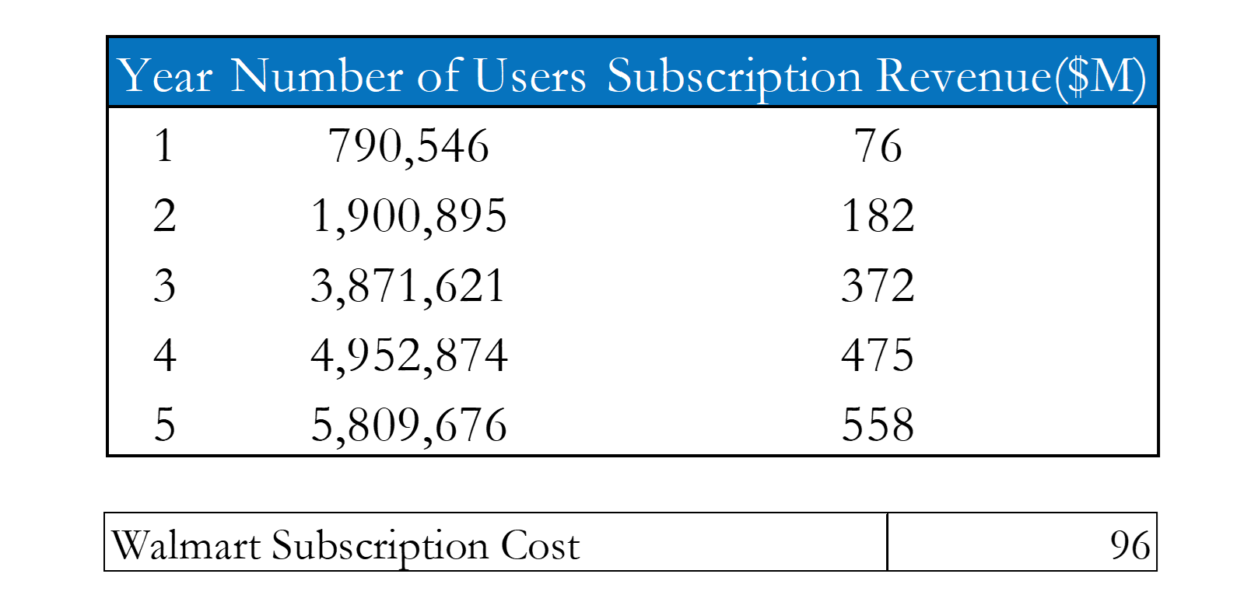
Providing Quantitative Justification - Revenues
Slide Takeaways
Appendix worksheet (not presented) This worksheet estimated the number of users who would use the subscription service and from this calculated the revenue per year The number of users per year was used in both revenue and expense calculations
Implementation | Financials | KPI | Risks and Mitigations
Notes:
Josh

Slide 32
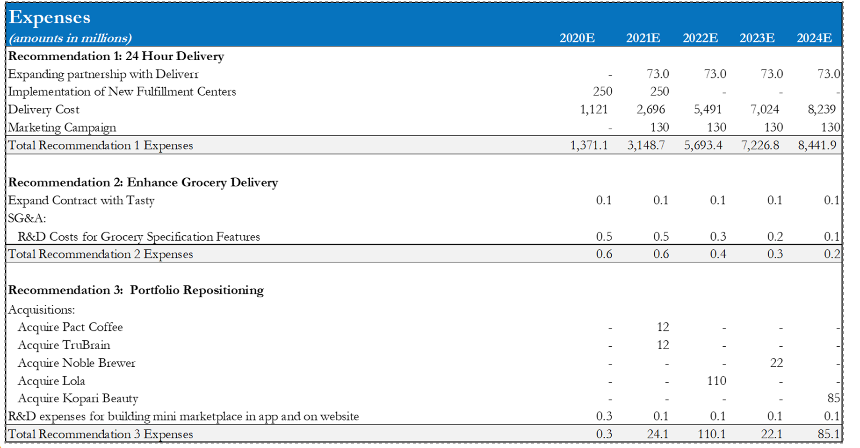
Implementing Ideas - Expenses
Implementing Ideas - Expenses
Slide Takeaways
Appendix worksheet (not presented) Defined expenses for individual recommendations
Implementation | Financials | KPI | Risks and Mitigations
Notes:
Josh

Slide 33
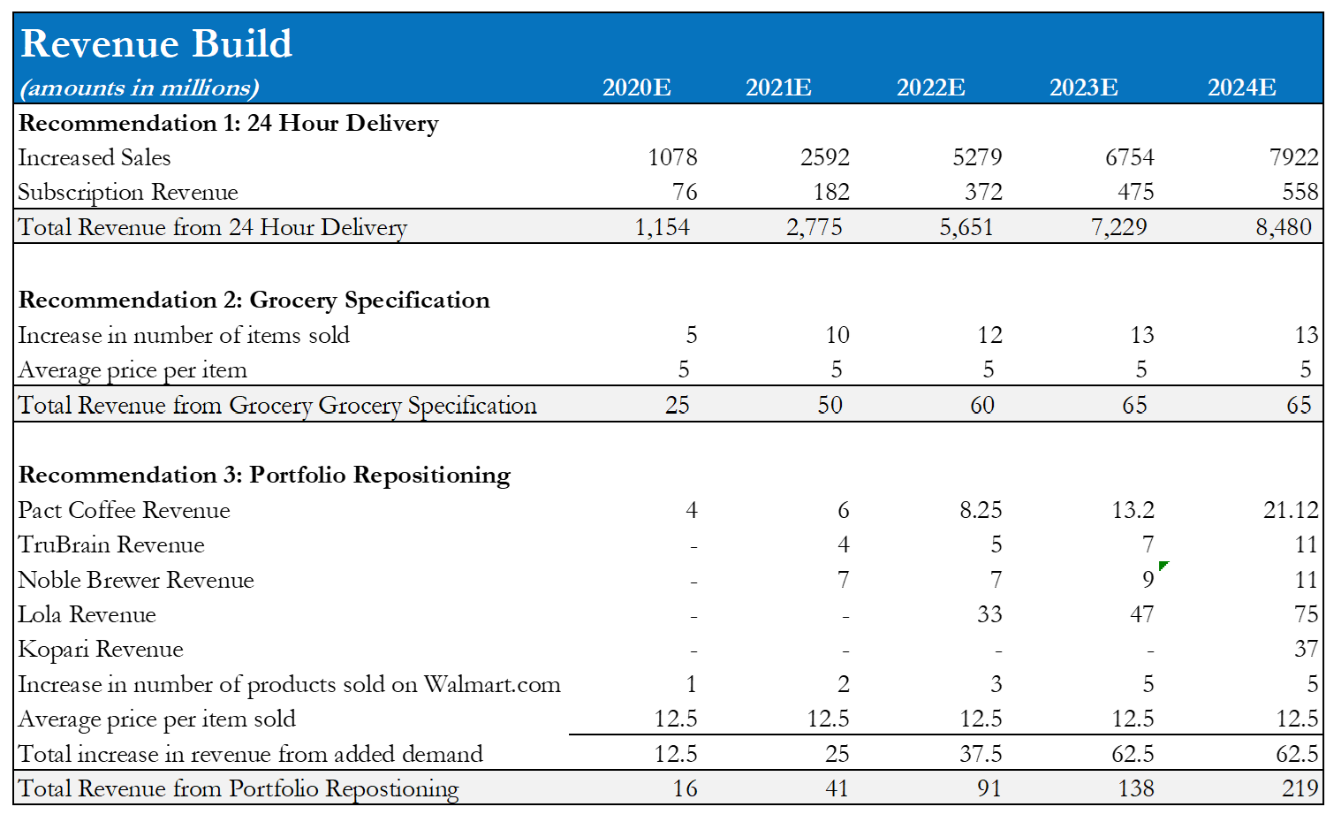
Implementing Ideas - Revenues
Slide Takeaways
Appendix worksheet (not presented) Defined revenues for individual recommendations
Implementation | Financials | KPI | Risks and Mitigations
Notes:
Josh

Slide 34
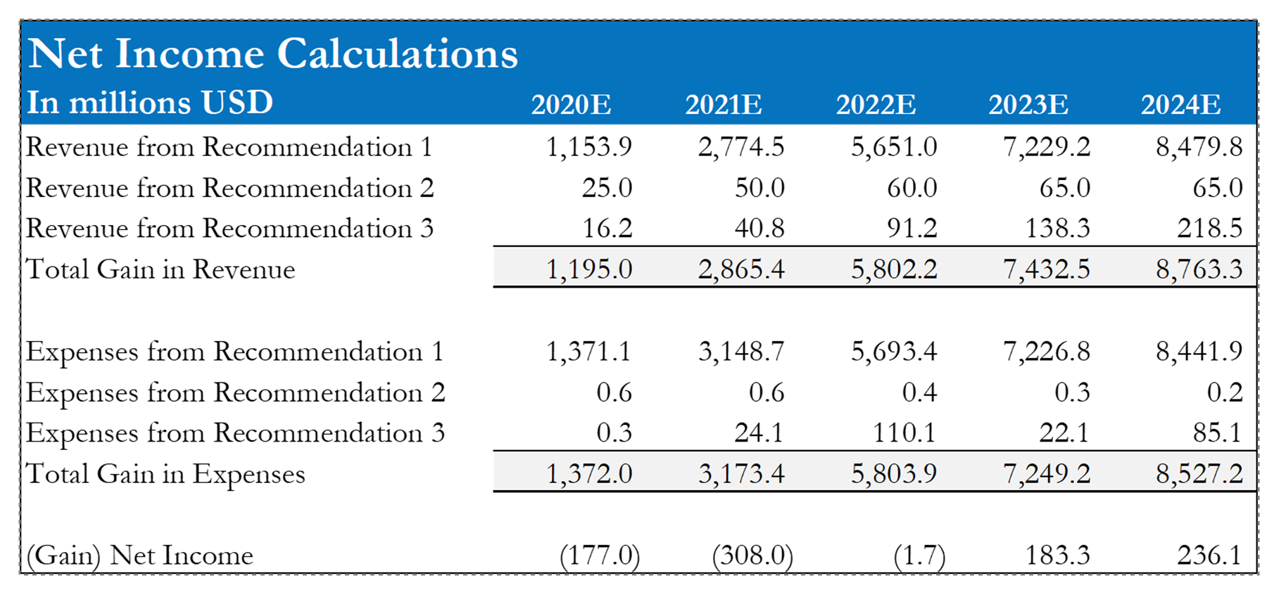
Further Analysis and Logic Check
Further Analysis and Logic Check
Slide Takeaways
Appendix worksheet (not presented) Last slides were very busy, this helps to summarize our recommendations Symmetry between models and slides helped to convey our point easier
Implementation | Financials | KPI | Risks and Mitigations
Notes:
Josh

Slide 35
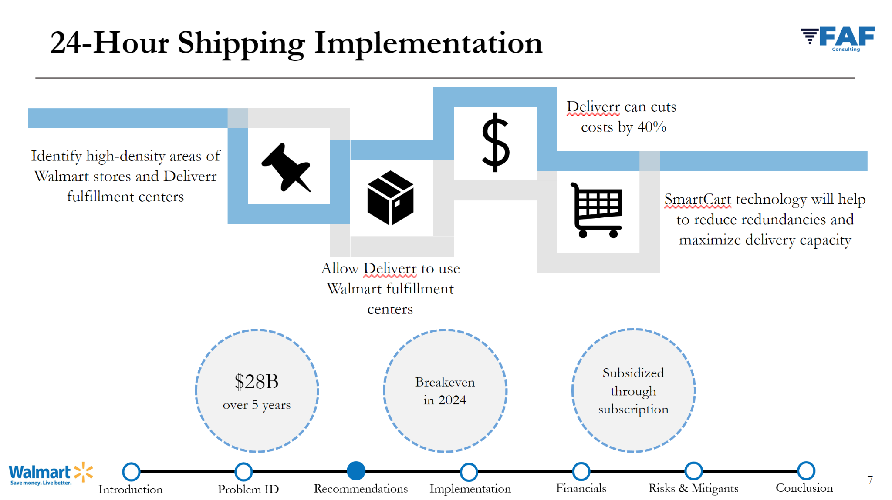
Presenting the Recommendation Model
Presenting the Recommendation Model
Slide Takeaways
Using key figures on a slide helps to show individual details but can leave judges wondering long term patterns Being able to reference individual points of data and then scale it to the big picture of a company helps to provide clarity and depth
Implementation | Financials | KPI | Risks and Mitigations
Notes:
Josh

Slide 36
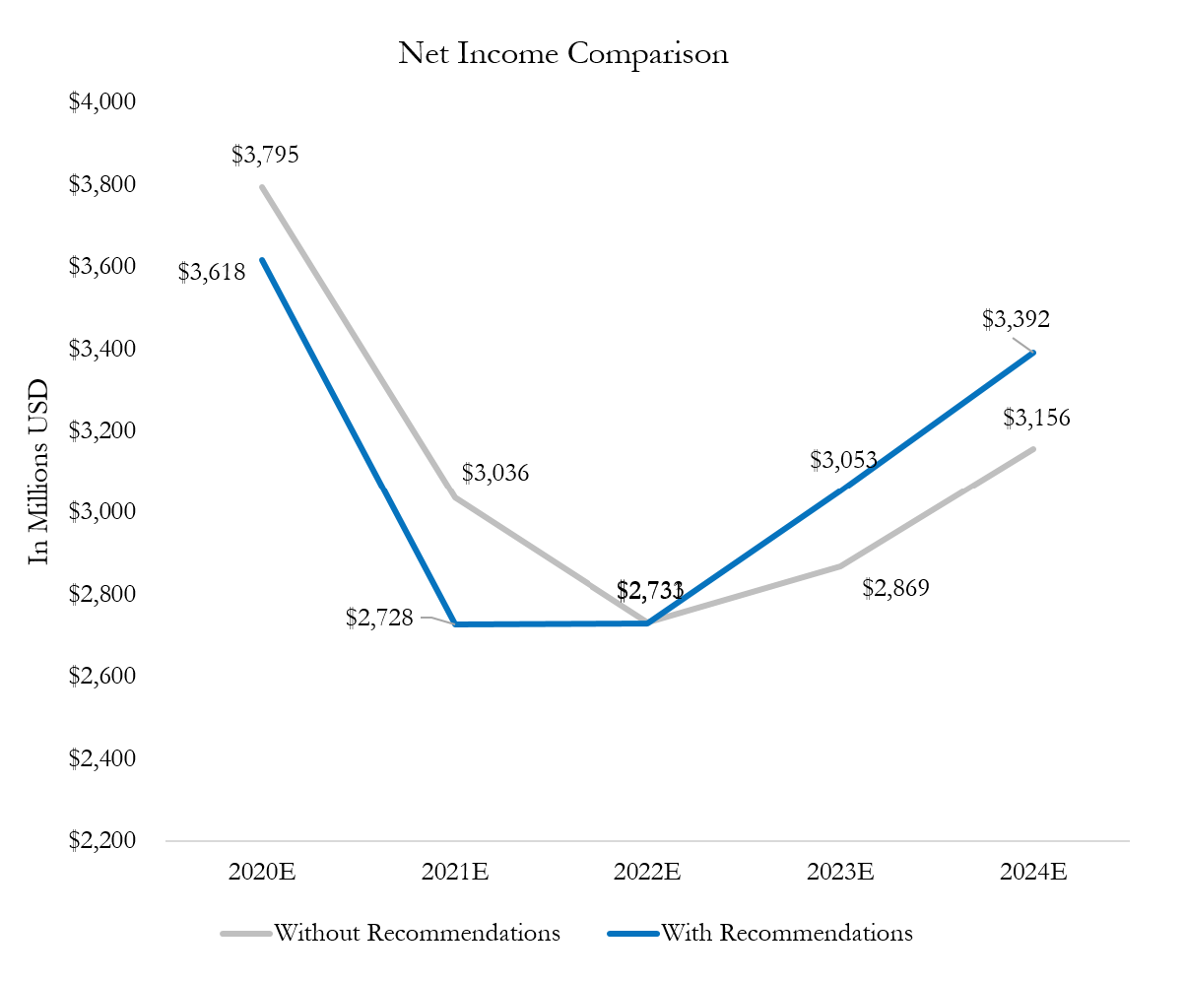
Presenting the Income Model
Presenting the Income Model
Slide Takeaways
Using a graph helps to show financial trends rather than details and specific data points Axis alterations and creative coloring can help further emphasize a major point Remember to label the time period and units that your graph is showing Can include text boxes summarizing what is happening in the graph
Implementation | Financials | KPI | Risks and Mitigations
Notes:
Josh

Slide 37
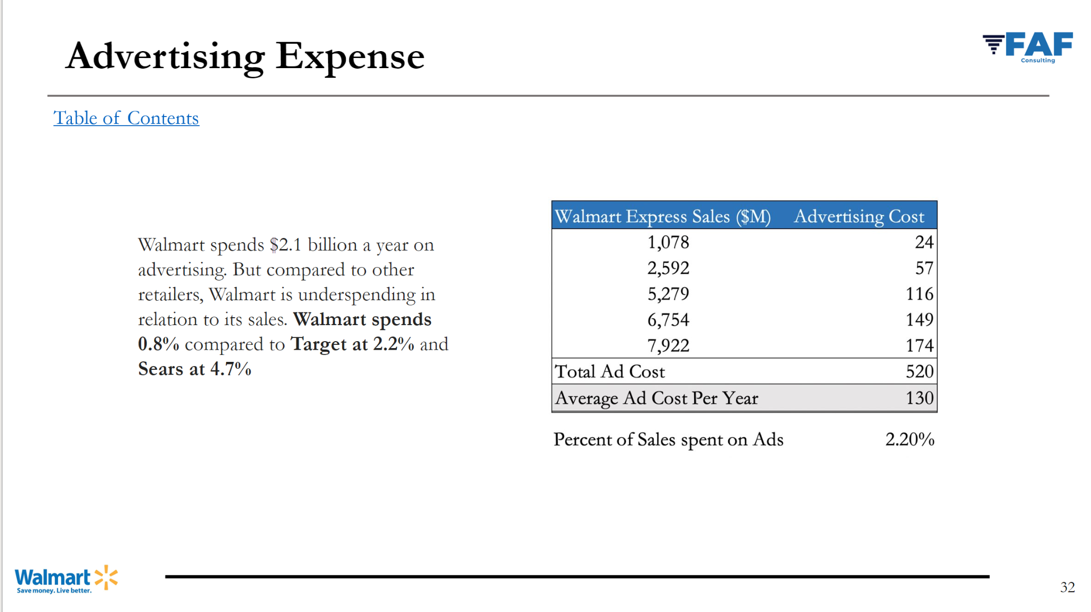
Answering Questions
Answering Questions
Slide Takeaways
An appendix has additional information and details that are not in the presentation deck A table of contents is a nice way to organize your appendix Every team member should have an idea what is in the appendix and be able to reference the appropriate slides while answering questions
Implementation | Financials | KPI | Risks and Mitigations
Notes:
Josh

Slide 38
Key Performance Indicators
KPIs are quantifiable goals used to determine the long term performance of a firm
4 Key Steps in the KPI Process
4. Assess
whether the KPIs are aligned with the original goals and determine the success of the recommendation
3. Change
strategies or initiatives based on the results of the KPIs over time
2. Evaluate
if the goals of the business are being met based on the KPIs
1. Identify
a set of KPIs to track the performance of a company
Implementation | Financials | KPI | Risks and Mitigations

Slide 39
How to Build KPIs
Quantifiable Target
Timeframe for Accomplishment
Data Source
Reporting Frequency
Questions to Ask:
Did You Get it Right?
What is your desired outcome?
How does this outcome align with your vision for success?
How will you know when you achieved your outcome?
Is this a leading measure of performance or a lagging measure?
Do you have at least 5-7 metrics that are essential to your vision for success?
Do you have a combination of leading and lagging indicators?
Is the measure and target for each clear enough to stand on its own?
It can be measured and tracked at least monthly?
Implementation | Financials | KPI | Risks and Mitigations

Slide 40
Example of KPIs
Implementation | Financials | KPI | Risks and Mitigations

Slide 41
Deconstructing KPIs
Related to Recommendations
Each KPI should be related to your slide’s recommendations
Quantifiable
Each KPI should have metrics explaining how your recommendations are being met
Implementation | Financials | KPI | Risks and Mitigations

Slide 42
Determining Potential Risks
Determining Potential Risks
Try to stay away from basic risks
such as:
High costs
Low revenue
Investor buy-in
Instead, hone in on specific issues that could be caused as a result of your recommendation, such as
Tech Considerations
Internal/External Impact
Federal Regulations
Social Reactions
Possible obsolescence of new technology
Lack of training
Tariffs and trade policies
New partner/
location has bad brand image
Cybersecurity of new recs
Language or cultural barriers with new partner
Exchanging big data between countries
Work process is expanded country is unethical
Implementation | Financials | KPI | Risks and Mitigations

Slide 43
Assigning Impact
Risk Matrix
How to assign impact on a risk matrix
HIGH
To help determine a risk’s impact on the company, here are some factors to take into consideration:
Probability
LOW
Cost to the company/ initial effect on profit
Ability to easily bounce back from or mitigate
Technical performance impact (if applicable)
Whether the company can function if the recommendation doesn’t pan out
LOW
HIGH
Impact
Green represents low level risk
Yellow represents medium risk
Red represents high/critical risk
(avoid having more than one rec in this area)
Implementation | Financials | KPI | Risks and Mitigations

Slide 44
Determine Mitigation Strategy
Mitigations should be how you are actively taking steps to combat the risk at hand *This is your last chance in your deck to cover any holes your recommendation
may have before the judges enter Q&A *
Example of good mitigation strategy
Rec
Risk
Mitigation
Create Under Armor flagship stores in China to increase brand recognition
Original unpopularity of flagship stores when opened
Leverage current athletic partnerships with celebs such as Stephen Curry to attract customers
With this mitigation, it shows a way the company can use something they already have in their arsenal to combat a potential risk/scenario
Implementation | Financials | KPI | Risks and Mitigations

Slide 45
Risk Analysis Process
Risk Analysis Process
Example
A popular deli in a small town is looking to expand to capture growing demand. Since their deli has developed a strong brand, they are thinking of opening a pizza place next-door to diversify their offerings. Your team assessed the idea, and are recommending the expansion. How would you implement this expansion while considering the risks and goals of the client?
1
2
3
Identify Risks
Assess Probability and Impact
Determine Mitigation Strategy
Customers in area don’t prefer pizza
Risk | Probability | Impact
Customers in area don’t prefer pizza | Low | High
Running two restaurants can dilute the original’s quality | High | Medium
Inefficient communication between restaurants | Medium | Low
Using demographic analytics, choose a more suitable location for the expanded location
Hire enough staff and promote select people to make sure production isn’t slowed or tainted
Running two restaurants can dilute the original’s quality
Inefficient communication between restaurants
Implement a POS system to integrate technology across both locations
Implementation | Financials | KPI | Risks and Mitigations

Slide 46
Upcoming Workshops
Implementation
& Risks
Storytelling
Workshop
Monday
October 9th
6:00pm
in AAG021
Wednesday
October 11th
6:00pm
in UUW324
Notes:
Anna
Update Dates

Slide 47
Questions?
Stay In Contact
Attendance
Email:
consulting@mcgbinghamton.com
Website:
mcgbinghamton.com
Instagram:
@mcgbinghamton
Notes:
Anna
Update dates
We will send this out so this is the last slide to present, tell them they'll have access to it

