Slide 1
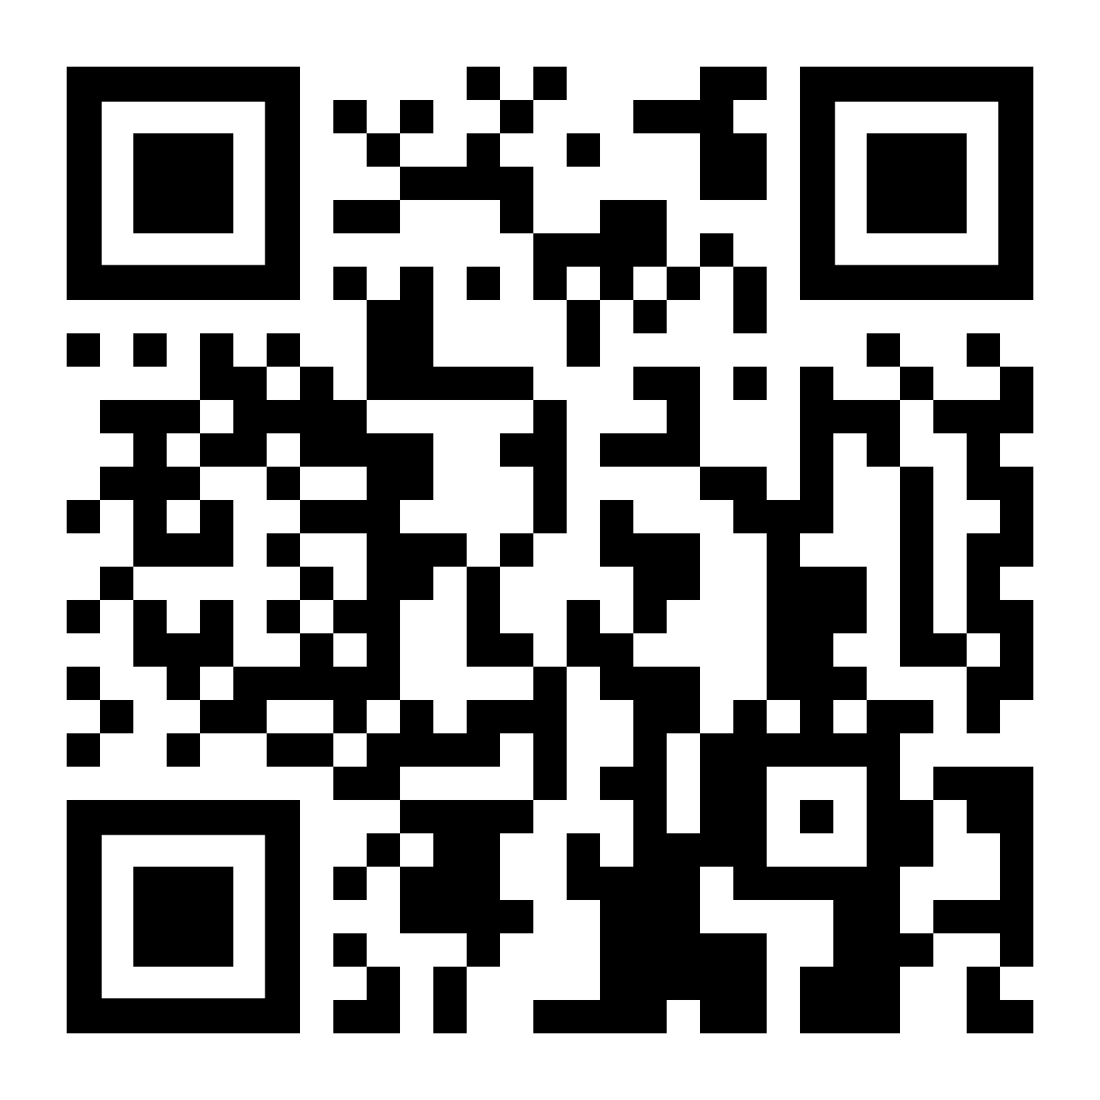
Storytelling Workshop
Wednesday, October 11th 2023

Slide 2
Agenda
Golden Circle
Questions to Ask Yourself
Different Approaches
3

Slide 3
Golden Circle
What?
Every organization knows what they do, these are their products or services
How?
Some know how they are special or what sets them apart from competition
Why?
Very few know why they are doing something, their purpose, cause, or belief
Notes:
Case Analysis:
Read over the case once
Read over again, pull out all relevant numbers
Analyze graphs, charts and other appendix info
Often used to put you in the right direction for the problem you’re trying to address
Questions and Company/Industry Analysis most important, often give the most info on what you’re trying to find/what everyone else is doing that works/doesn’t work

Slide 4
Golden Circle Application Example
Example Company: Patagonia
WHAT
What?
Patagonia offers gear and apparel suited towards those with outdoor-oriented lifestyles and hobbies
HOW
How? Patagonia operates through e-commerce and physical storefronts, and are known for the high quality, durability, and sustainability of their products
WHY
Why?
Patagonia provides these sustainable products to help the environment and those who support it, made clear by the recent actions of its CEO

Slide 5
Questions to Ask Yourself
Using the Golden Circle can help to understand your audience and their wants
What products and services does the company offer? Do these appeal to the target audience? What needs improvement?
When considering recommendations, make sure not to abandon what differentiates the company in its market
What are the key values of your target demographics? Where do these values overlap with those of the company?

Slide 6
Questions to Ask Yourself
The Key Consumer
Who is the company looking to target?
What is the company’s biggest demographic?
What consumer market should the company target for the future?
Follow Their Experiences
When does your customer begin to interact with this company?
What steps do they take and how do they feel?
How does this company create a positive experience?
Highlight Good and Bad
What are the positive aspects of the company currently?
What are the key pain points of the consumer?
What could be altered/removed/refined to improve consumer experience?
This information can come from the case itself or external research. Think through it like the company’s C-Suite, but also as a consumer.

Slide 7
Different Approaches: Personas
Persona Example
Tell a Story through the Consumer Viewpoint
Blake
Age: 19
Blake is unemployed
so he uses his parents’ money whenever he goes out.
Create a
persona
Map their experiences
Walk through
their shoes
Motivation:
With a lack of disposal income on his own, Blake wants cheap and quick meals when hungry.
Pain Points:
When buying pizza, Blake doesn’t enjoy the ambiance of the $1 dollar pizza store. The lines are also too long, and he gets annoyed
Flush out examples of the target demographic
What are their preferences, lifestyle/wants, etc.?
Think about the entire consumer experience:
Consider the entire process a consumer would take
Imagine yourself as the persona you created:
What parts of the experience would make you unhappy?

Slide 8
What is a Journey Map?
Takes a deeper look into one or multiple consumers’ growth and interaction with a company and its products and services
Uses a grid-like structure and trend line to visually document experiences and satisfaction while engaged with company
Helps identify weak points of currently-offered experience to help fine-tune recommendations and personalize presentation

Slide 9
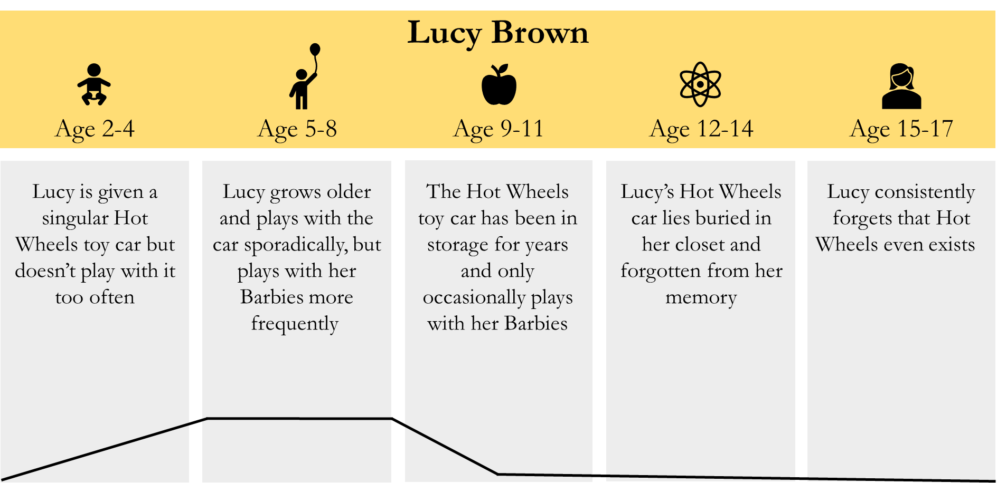
Example Journey Map
Columns clearly and neatly show persona’s age to provide sequence
Trend line shows interest in example company, Hot Wheels, over lifetime

Slide 10
Example Journey Map
Instead of lifetime, this shows persona’s experience based on one interaction
Buys Gucci to give sense of fame to his social media posts
Sees little increase in digital popularity through his investment
Featured in new social media campaign, @generationgucci
Interactions on posts increase as consumers look to join in trends
Travis
Integrates recommendation to refine consumer experience
Trend line shows happiness with example company, Gucci, over time

Slide 11
5 Whys Method: A Practical Example
Matt got a speeding ticket on his way to school from his apartment
Why?
He was running behind and had to speed to make up the time
Why?
He woke up late because he didn’t hear his alarm ring
Why?
His alarm did not go off at all
Why?
The batteries in his alarm were dead
Why?
He forgot to replace the batteries in his alarm

Slide 12
Solving Key Issues
The final issue from the previous slide… “He forgot to replace the batteries in his alarm”
How can he solve this? Invest in an alarm that plugs into the wall, or set a schedule to change the batteries every 6 months
If this root cause can be eliminated (by a solution such as the one above), then all of the issues that stem from it will also be eliminated. This is known as the root-cause analysis.
Using a combination of these methods and a vast foundation of information, you will be able to identify what is wrong with the company and what causes it
In order to start repairing the issues you have identified, you must again go to research to begin building a recommendation
The recommendations you are providing must be backed in logic in each facet (operational, financial, technological) in order to be a successful solution

Slide 13
Building Your Recommendations
Ideally, there should be three recommendations that aim to cover the issues previously outlined. These solutions can each tackle a different issue, or be allotted to the same issue depending on the circumstances.
Recommendation Do’s:
Recommendation Don’ts:
Make sure that your recommendations address both short and long term issues
Make decisions based on information outside of the case date
Align the recommendations with the company’s core values and mission
Contradict one recommendation with a different recommendation
Understand every facet of what you are recommending – not just buzzwords
Tailor your problems to your recommendations
Back up your recommendations with logical financial estimates and projections
Go against the CEO’s vision for the company’s future

Slide 14
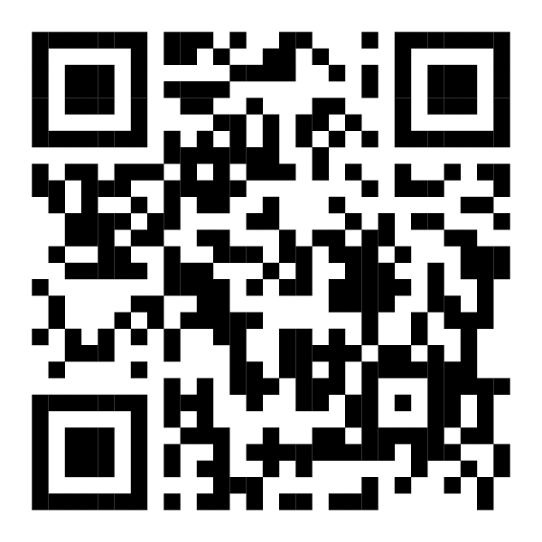
Questions?
Stay In Contact
Attendance
Email:
consulting@mcgbinghamton.com
Website:
mcgbinghamton.com
Instagram:
@mcgbinghamton
Notes:
Anna
Update dates
We will send this out so this is the last slide to present, tell them they'll have access to it

