Slide 1
Implementation and Risks
Monday, October 9th 2023

Slide 2
Agenda
Research
Implementation
Risks
Risks
Mitigations
Mitigations

Slide 3
Research for Implementation and Risks
Gather
Research
Analyze
Case Prompt
Client documents (website, online articles & reports)
Statistics
Client industry
Breakdown of your recommendations implementation wise
Obstacles companies face or may face when implementing similar ideas
Feasibility of implementation
Evidence of support for best plan
Show how you considered any hole of your recommendations

Slide 4
Implementation Plans
Your implementation plan should be the “roadmap” of your recommendations
What your plan should include:
Having a client centered implementation
Detailed breakdown of activities
[short term, long term]
Costs/projected revenues
Consistent time breakdown
[quarters, months, years. etc]
Impactful
Relevant
Feasible
Incorporating Research
Expected difficulties
Use ideologies such as Porter’s 5 forces to get a sense of integration time, feasibility, etc.
Check ins/maintenance of recommendations
[how do we/how often do we check to make
sure the recommendation is being effective?]
Look at comparable companies and how long it took to implement similar recommendations
[Keep company size and scale in mind with this: ex. Burger
King and McDonalds]
Dissect each recommendation into milestones

Slide 5
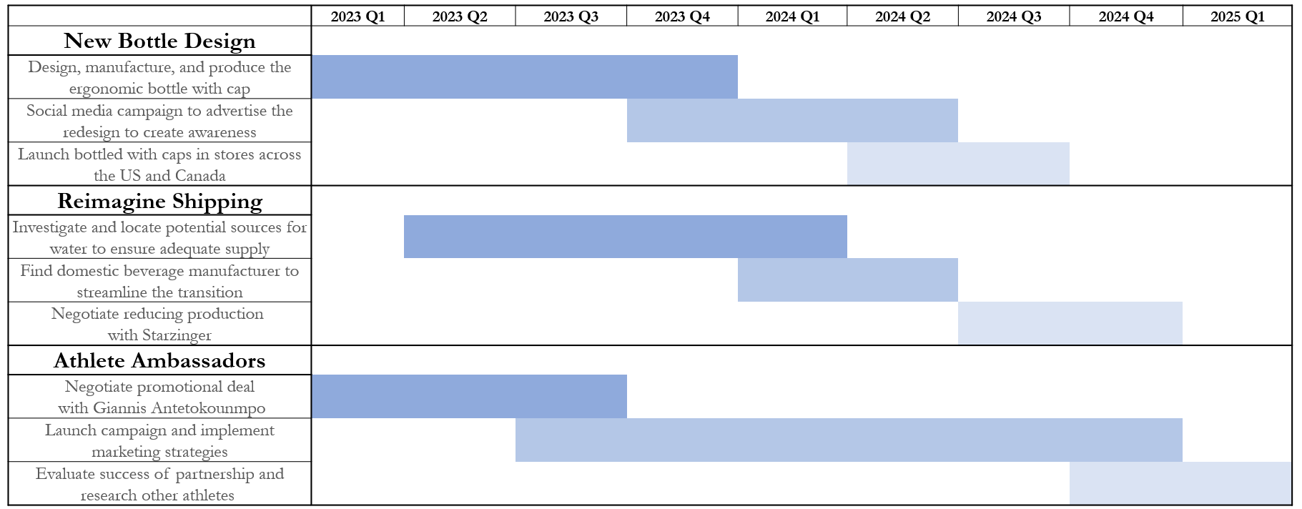
Creating a Timeline - Gantt Chart
Gantt Chart
Pros
Ability to clearly show duration of each task
Aesthetically pleasing
Cons
Can be time-consuming to create if the timeline is detailed
(Often times can be a nice appendix slide)

Slide 6
Creating a Timeline - Arrow
Arrow or Classic Timeline
Pros
Visuals clearly go from present to future
Design is aesthetically pleasing
Q1 2019
Task #1
Q2 2019
Task #2
Q4 2019
Task #3
Q1 2020
Task #4
Q2 2020
Task #5
Cons
Cannot visually show task duration
Details
Details
Details
Details
Details
May run out of space on slide depending on detail

Slide 7
Creating a Timeline - Table
Table
Pros
Ability to include a fairly detailed timeline
Task | Start | End | Duration
Task #1 | Nov-19 | Nov-20 | 1 year
Task #2 | Jan-20 | June-20 | 6 months
Task #3 | Jan-20 | Jan-22 | 2 years
Task #4 | Sep-20 | Mar-21 | 6 months
Task #5 | Jan-21 | Jan-22 | 1 year
Concise, minimalistic layout
Cons
Can’t show single time events
(e.g. launches)
No clear visual representation of task duration

Slide 8
Example Problem
Create an implementation plan for this recommendation:
A popular deli in a small town is looking to expand to capture growing demand. Since their deli has developed a strong brand, they are thinking of opening a pizza place sister location to diversify their offerings. Your team assessed the idea, and are recommending the expansion. How would you implement this expansion while considering the risks and goals of the client?
We recommend following this process:
1.) Be sure to consider the specific steps necessary to make this happen
2.) Research how long each step in the implementation would take
3.) Order the steps and create a visual representing your implementation

Slide 9
Example Problem (cont.)
Create an implementation plan for this recommendation:
A popular deli in a small town is looking to expand to capture growing demand. Since their deli has developed a strong brand, they are thinking of opening a pizza place sister location to diversify their offerings. Your team assessed the idea, and are recommending the expansion. How would you implement this expansion while considering the risks and goals of the client?
1.) Consider the specific steps necessary to make this happen
Securing funds (How will we raise money? That has its own implementation)
Researching and choosing the property location (Thinking of demographics)
Purchasing the property
Marketing (How will you market this new location and for how long?)
Property renovations (Depending on what you bought, how much needs to be changed?)
Hiring and training new workers (How long is the training process?)
Store opening

Slide 10
Example Problem (cont.)
2.) Research how long each step in the implementation would take
3.) Order the steps and create a visual representing your implementation plan
Task | Start | End | Duration
Choose ideal location | May 15, 2019 | August 15, 2019 | 3 months
Purchase property | Aug. 15, 2019 | Sept. 15, 2019 | 1 month
Marketing | Sept. 15, 2019 | Mar. 15, 2019 | 6 months
Renovate property | Oct. 1, 2019 | Mar. 1, 2019 | 5 months
Hire and train new workers | Jan. 1, 2019 | Mar. 1, 2019 | 2 months
Notes:
Why did we choose to use this example

Slide 11
Determining Potential Risks
Try to stay away from basic risks
such as:
High costs
Low revenue
Investor buy-in
Instead, hone in on specific issues that could be caused as a result of your recommendation, such as
Tech Considerations
Internal/External Impact
Federal Regulations
Social Reactions
Possible obsolescence of new technology
Lack of specialized employee training
Tariffs and domestic/
internatiomal trade policies
New partner/
location has bad brand image
Potential Cybersecurityrisks of new recs
Language or cultural barriers with new partner
Exchanging big data between countries
Work process is expanded country is unethical

Slide 12
Assigning Impact
Risk Matrix
Some factors to take into consideration when assigning impact on a risk matrix:
HIGH
Probability
Cost to the company/ initial effect on profit
Ability to easily bounce back from or mitigate
Technical performance impact (if applicable)
Whether the company can function if the recommendation doesn’t pan out
LOW
LOW
HIGH
Impact
Green = low level risk
Yellow = medium risk
Red = high/critical risk
**avoid having more than one rec in this area

Slide 13
Determine Mitigation Strategy
Mitigations should be how you are actively taking steps to combat the risk at hand
*This is your last chance in your deck to cover any holes your recommendation may have before the judges enter Q&A *

Slide 14
Mitigation Strategy Example
Example of good mitigation strategy
Rec
Risk
Mitigation
Leverage current athletic partnerships with celebs such as Stephen Curry to attract customers
Create Under Armor flagship stores in China to increase brand recognition
Original unpopularity of flagship stores when opened
With this mitigation, it shows a way the company can use something they already have in their arsenal to combat a potential risk/scenario

Slide 15
Risk Analysis Process
Example
A popular deli in a small town is looking to expand to capture growing demand. Since their deli has developed a strong brand, they are thinking of opening a pizza place next-door to diversify their offerings. Your team assessed the idea, and are recommending the expansion. How would you implement this expansion while considering the risks and goals of the client?

Slide 16
Risk Analysis Process Example
1
2
3
Identify Risks
Assess Probability and Impact
Determine Mitigation Strategy
Customers in a specific area don’t prefer pizza
Use demographics to find a better expansion spot.
Risk | Probability | Impact
Customers in area don’t prefer pizza | Low | High
Running two restaurants can dilute the original’s quality | High | Medium
Inefficient communication between restaurants | Medium | Low
Hire enough staff and promote select people to make sure production isn’t slowed or tainted
Running two restaurants can dilute the original’s quality
Inefficient communication between restaurants
Implement a POS system to integrate technology across both locations

Slide 17
Upcoming Workshops
Storytelling
Workshop
Wednesday
October 11th
6:00pm
in UUW324
Notes:
Anna
Update Dates

Slide 18
Questions?
Stay In Contact
Attendance
Email:
consulting@mcgbinghamton.com
Website:
mcgbinghamton.com
Instagram:
@mcgbinghamton
Notes:
Anna
Update dates
We will send this out so this is the last slide to present, tell them they'll have access to it

