Slide 1
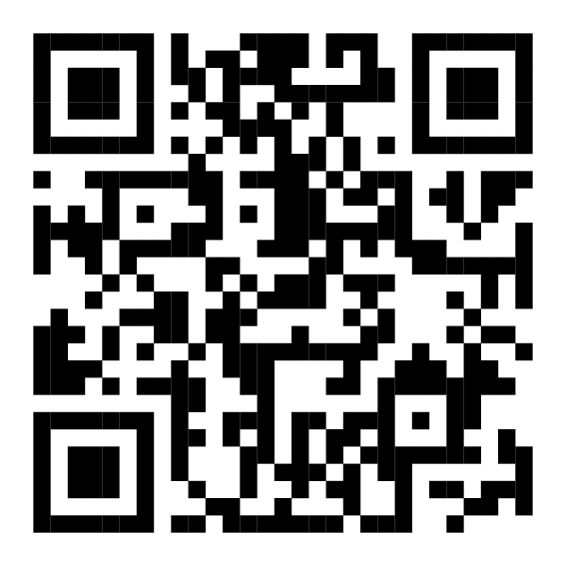
Case Theory Workshop
Tuesday, October 3rd 2023

Slide 2
Agenda
Case Analysis
Identifying Key Issues
Building Recommendations

Slide 3
Case Components
Case Success
Problem Identification
Implementation
Plan
Financial Implications
Risk Considerations
Recommendation
Components
Notes:
Case Analysis:
Read over the case once
Read over again, pull out all relevant numbers
Analyze graphs, charts and other appendix info
Often used to put you in the right direction for the problem you’re trying to address
Questions and Company/Industry Analysis most important, often give the most info on what you’re trying to find/what everyone else is doing that works/doesn’t work

Slide 4
Breaking Down a Case
Before Meeting with your Team
Early Team Meetings
Read over case twice
Develop a game-plan
First case read-through is used for context and familiarity
Second time is in-depth; look for numbers, questions, and trends
Company and Industry Analysis will give the most context
Compare findings from prior case readings with the group
Highlight surface issues, drill deeper to find key issues & root causes
Brainstorm potential solutions to correct these issues
Notes:
Case Analysis:
Read over the case once
Read over again, pull out all relevant numbers
Analyze graphs, charts and other appendix info
Often used to put you in the right direction for the problem you’re trying to address
Questions and Company/Industry Analysis most important, often give the most info on what you’re trying to find/what everyone else is doing that works/doesn’t work

Slide 5
Recognizing the Case’s Scope
Narrow Scope
Case asks a specific question or is looking to push in a certain direction
Analysts have less freedom; must stick to the path of the case to succeed
Research is needed to differentiate from others and find creative solutions
Broad Scope
Case asks a series of questions that can all be answered in equal depth
Often encourages more creativity and gives analysts freedom to choose
Prioritize issues believed to be key, and dig deeper to narrow the scope

Slide 6
Identifying Key Issues
You must identify the problems before creating recommendations
Issues can come from within the company itself, or come externally from shifting industry trends or actions of competitors
Use methods such as the 5 Whys or the Root-Cause Analysis to get from the surface to the core of the issues that are at hand
Piece together information provided in the case with outside research to see where and why the company is struggling

Slide 7
Identifying Key Issues Through Personas
Persona Example
Empathy Based Problem Identification
Blake
Age: 19
Blake is jobless so he uses his parents money when he goes out.
Create a
persona
Map their experiences
Walk through
their shoes
Motivation:
With a lack of disposable income on his own, Blake wants cheap and quick meals when hungry.
Pain Points:
When buying pizza, Blake doesn’t enjoy the ambiance of the one-dollar pizza store. The lines are also too long, and he gets annoyed.
Flesh out examples
of the target demographic
What are their preferences, lifestyle/wants, etc?
Think about the entire consumer experience:
Start from thinking about the product
to receiving it
Imagine yourself
as the persona
you created:
What parts of the experience would
make you mad?

Slide 8
Building Your Fact-Base
Company Values, Mission Statement Recent Financial Performance Management/Ownership Changes & Corporate Governance Consolidations, Acquisitions, Divestitures
Company
Specific
Key Competitors – Performance, Strategy Changes Trends within Industry (Automation, E-Commerce) New Regulations and other “Current” Events Important Metrics and Benchmarks (RevPAR, RevPAS, BPD)
Industry
Specific
Current Economic Trends (Disposable Income, Consumer Spending)
Geographic restrictions or concerns
Legal or Regulatory issues pertaining to industry or country Environmental regulations or initiatives
General Information
This information can come from the case itself or external research. Research is essential in every component of a case in order to achieve success.

Slide 9
5 Whys Method: A Practical Example
Matt got a speeding ticket on his way
to school from his apartment
Why?
He was running behind and had to
speed to make up the time
Why?
He woke up late because he didn’t
hear his alarm ring
Why?
His alarm did not go off at all
Why?
The batteries in his alarm were dead
Why?
He forgot to replace the batteries
in his alarm

Slide 10
Solving Key Issues
The final issue from the previous slide… “He forgot to replace the batteries in his alarm”
How can he solve this? Invest in an alarm that plugs into the wall, or set a schedule to change the batteries every 6 months
If this root cause can be eliminated (by a solution such as the one above), then all of the issues that stem from it will also be eliminated. This is known as the root-cause analysis.
Using a combination of these methods and a vast foundation of information, you will be able to identify what is wrong with the company and what causes it
In order to start repairing the issues you have identified, you must again go to research to begin building your series of recommendations
The recommendations you are providing must be backed in logic in each facet (operational, financial, technological) in order to be a successful solution

Slide 11
Building Your Recommendations
Ideally, there should be be three recommendations that aim to cover the issues previously outlined. These solutions can each tackle a different issue, or be allotted to the same issue depending on the circumstances.
Recommendation DO’S:
Recommendation DON’TS:
Make sure that your recommendations address both short and long term issues
Make decisions based on information outside of the case date
Align the recommendations with the company’s core values and mission
Contradict one recommendation with a different recommendation
Understand every facet of what you are recommending – not just buzzwords
Tailor your problems to your recommendations
Back up your recommendations with logical financial estimates and projections
Go against the CEO’s vision for the company’s future

Slide 12
Logistics
Round 1
Round 2
Round 3
Friday, October 13th
72 teams competing
10-minute Presentation 5-minute Q&A
5-minute Feedback
Submit by:
11:59pm on October 12th
Judged by MCG E-Board
304 students competing
Friday, October 27th
8 teams are selected
10-minute Presentation 5-minute Q&A
5-minute Feedback
Submit by:
11:59pm on October 26th
Judged by EY Professionals at Binghamton University
Networking opportunities with EY Professionals
Friday, November 3rd
4 teams are selected
12-minute Presentation 5-minute Q&A
5-minute Feedback
Submit by:
11:59pm on November 2nd
Judged by EY Professionals at EY Headquarter in Manhattan with networking opportunities.
Notes:
Anna
Remind them that second round is in class and they must attend, Update Dates

Slide 13
Submissions
Submission Before Round 1
Only ONE team member should submit by email to consulting@mcgbinghamton.com due by the end of the day
11:59pm on Thursday October 12th
Submit as a PowerPoint Presentation (.PPTX) and PDF
(NOT Google Slides)
Notes:
Anna
Update Dates

Slide 14
Upcoming Workshops
Success
Metrics
Implementation
& Risks
Storytelling
Workshop
Thursday
October 5th
6:00pm
in AAG023
Monday
October 9th
6:00pm
in AAG021
Wednesday
October 11th
6:00pm
in UUW324
Notes:
Anna
Update Dates

Slide 15
Questions?
Stay In Contact
Attendance
Email:
consulting@mcgbinghamton.com
Website:
mcgbinghamton.com
Instagram:
@mcgbinghamton
Notes:
Anna
Update dates
We will send this out so this is the last slide to present, tell them they'll have access to it

